Slide 1
MACHINE LEARNING CLUSTERING Bisecting K-means Clustering

Slide 2
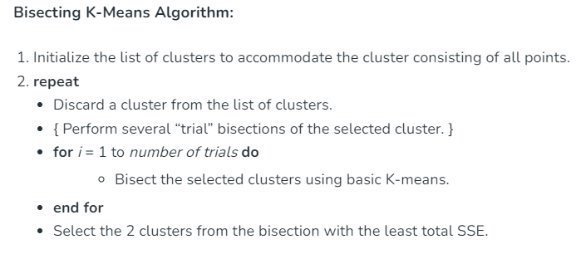

Slide 3
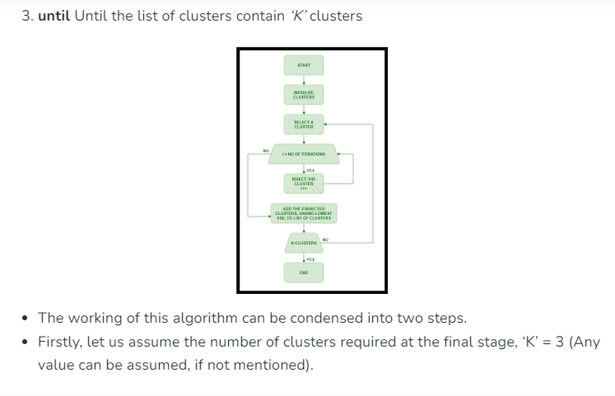

Slide 4
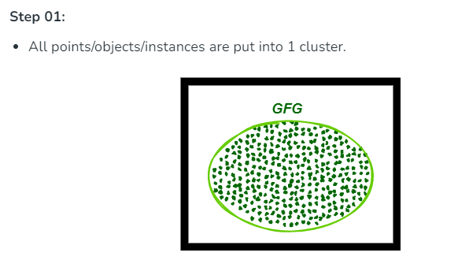

Slide 5
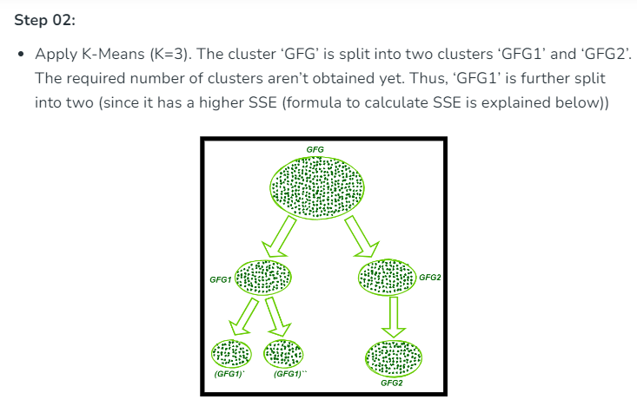

Slide 6
